Slide 1
Progress report: Maryland Labor Market Inequality Elberth Ndounou Yindas DATA 205

Slide 2
Research Question and Roadmap
Main question: Which factors drive wage gaps in Maryland?
Two parts: structural sorting and within‑job gaps
Roadmap: Data → Cleaning → EDA → Regression & Decomposition → Policy implications

Slide 3
Data Sources and Key Variables
ACS PUMS 2024: wages, hours, occupation, education, race, sex, nativity, disability, person weight PWGTP
BLS OEWS May 2024: occupation median wages, employment counts, location quotients
Sample: ~145k sampled workers → ~2.9M weighted population

Slide 4
Data Cleaning Steps
Remove missing or zero wages and under 18
1
Create annual hours = weeks × hours; define full‑time vs part‑time
2
Collapse education into five tiers; create race_eth groups
3
Map OCCP to 2‑digit SOC groups; create STEM indicator
4
Save cleaned dataset for analysis
5

Slide 5
Exploratory Data Analysis Highlights
Treemap: employment size and median wage by occupation (OEWS)
KDEs: wage distributions by race for full‑time workers (ACS)
Dumbbell chart: male vs female median wages by occupation (ACS)
Heatmap: education × occupation wage interaction; top majors by wage

Slide 6
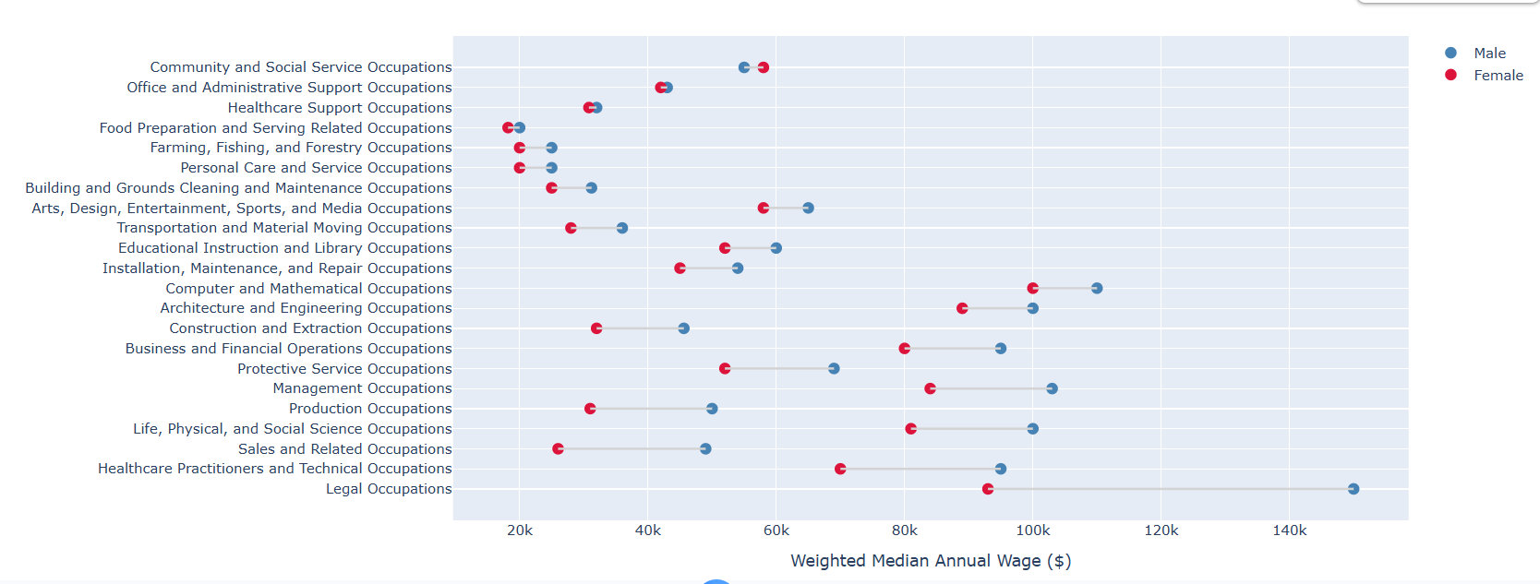
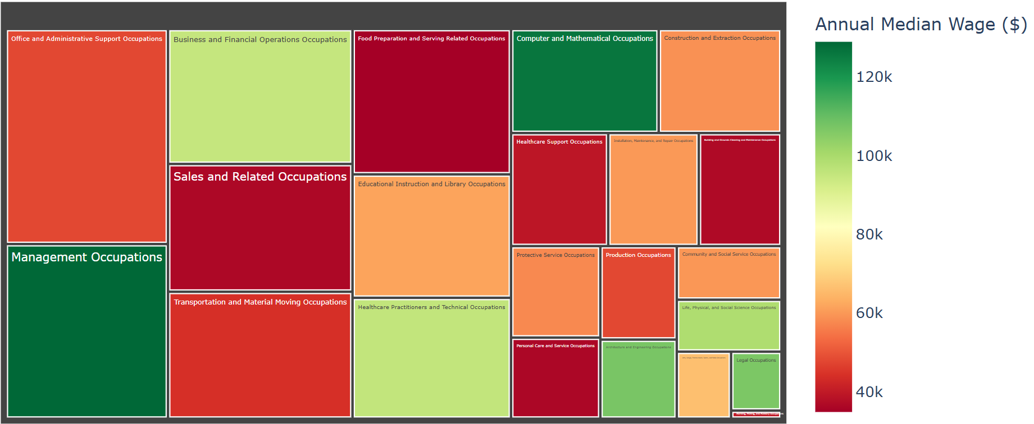
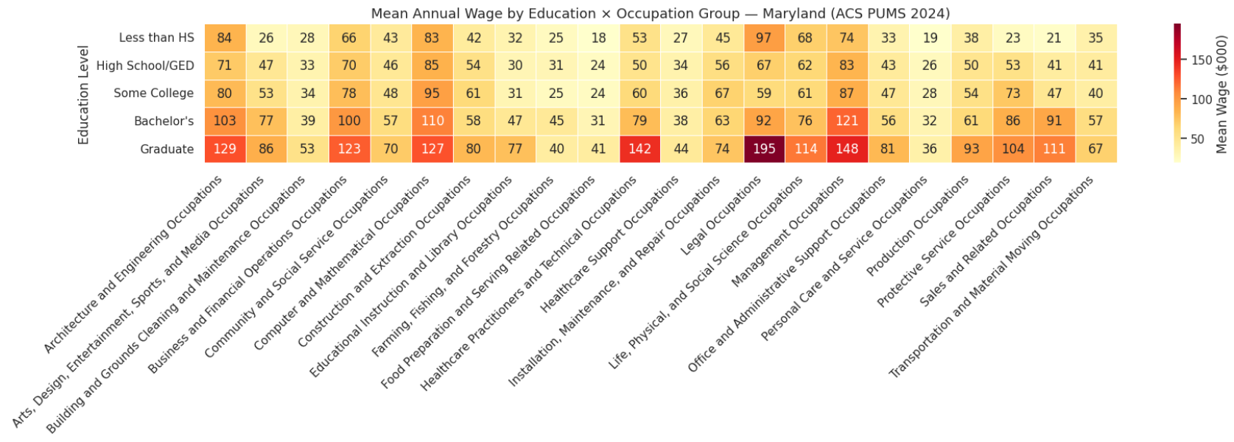
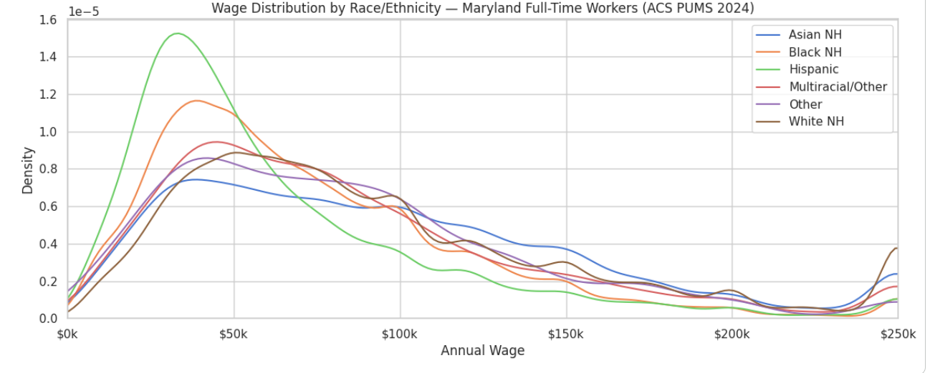

Slide 7
What the EDA Suggests
Maryland has a two‑tier market: many low‑wage service jobs and fewer high‑wage professional jobs
Gender and racial gaps appear both from sorting and within occupations
STEM raises wages, but returns vary by race and gender

Slide 8
Planned Analysis and Deliverables
Weighted regressions with occupation fixed effects to measure conditional gaps
Blinder–Oaxaca decomposition to split explained vs unexplained gap (White vs Black)
Interaction tests (STEM × race), sector analysis (federal vs private), robustness checks

